Slide 1
Trees
Instructor : Saba Saeed

Slide 2
Introduction to Trees
Tree definition
A tree is a set of nodes.
The set may be empty
If not empty, then there is a distinguished node r, called root and zero or more non-empty subtrees T₁, T₂, … T_{k}, each of whose roots are connected by a directed edge from r.
Basic Terminology
Root of a subtree is a child of r. r is the parent.
All children of a given node are called siblings.
A leaf (or external) node has no children.
An internal node is a node with one or more children

Slide 3
Tree Examples
Family Trees.
Organization Structure Charts.
Program Design.
Structure of a chapter in a book.

Slide 4
More Terminologies
Path
A sequence of edges
Length of a path
number of edges on the path
Depth of a node
length of the unique path from the root to that node
Height of a node
length of the longest path from that node to a leaf
all leaves are at height 0
The height of a tree = the height of the root = the depth of the deepest leaf
Ancestor and descendant
If there is a path from n1 to n2
n1 is an ancestor of n2, n2 is a descendant of n1

Slide 5
Parts of a Tree
nodes

Slide 6
Parts of a Tree
parent node

Slide 7
Parts of a Tree
parent node
child nodes

Slide 8
Parts of a Tree
parent node
child nodes

Slide 9
Parts of a Tree
leaf nodes
root node

Slide 10
Parts of a Tree
sub-tree

Slide 11
Binary Tree
Each node can have at most 2 children

Slide 12
Full Binary Tree
A full binary tree is a binary tree in which each node either is a leaf or has exactly two nonempty descendants. In a full binary tree of height h:
1. # leaves = (# internal nodes) + 1.
2. # leaves is at least h+1 and at most 2^{h}.
3. # internal nodes is at least h and at most 2^{h}-1.
4. Total number of nodes is at least 2h+1 and at most 2^{h+1}-1.
5. Height h is at least lg(n+1) and at most (n-1)/2

Slide 13
Size of a Node: the number of descendants the node has (including the node itself). The size of root is the size of a tree. The size of a leaf is 1.
A
Node Height Depth Size
A 3 0 8
B 1 1 3
C 0 1 1
D 2 1 3
E 0 2 1
F 0 2 1
G 1 2 2
H 0 3 1
B
C
D
E
F
G
H

Slide 14
Recursion and Trees
Because tress can be defined recursively, many tree routines, not surprisingly, are most easily implemented by using recursion.
Any non-empty tree consists of the root node, its left subtree and its right subtree. (The subtree may be empty). Because the subtrees are also tree, if an operation works for tree, we can also apply it on the subtrees.

Slide 15
Traversal
Systematic way of visiting all the nodes.
Methods:
Preorder, Inorder, and Postorder
They all traverse the left subtree before the right subtree.
The name of the traversal method depends on when the root node is visited.

Slide 16
Tree Traversal
Preorder: traverse the node itself first, then all nodes in the LEFT subtree , then all nodes in the RIGHT subtree.
Inorder: Traverse all nodes in the LEFT subtree first, then the node itself, then all nodes in the RIGHT subtree.
Postorder: Traverse all nodes in the LEFT subtree first, then all nodes in the RIGHT subtree, then the node itself,

Slide 17
preorder : 1 2 4 5 3 6
inorder : 4 2 5 1 3 6
postorder : 4 5 2 6 3 1
1
2
3
4
5
6

Slide 18
1
preorder : 1 … ...
inorder : … 1 ...
postorder : … … 1
2
3
4
5
6
7
8
9
10

Slide 19
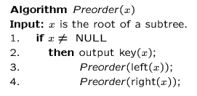
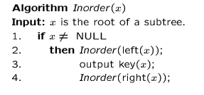
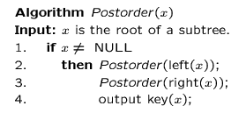
Preorder, Postorder and Inorder Pseudo Code

Slide 20
Time Complexity of tree traversal
Traversals take O(n) time for a tree with n nodes, because we visit and print each node once, with constant cost associated with moving between nodes and printing them

Slide 21
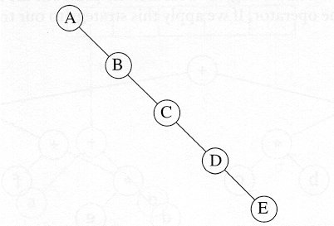
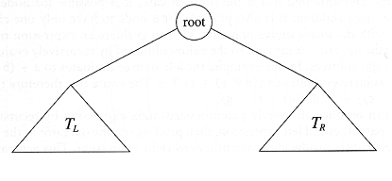
Binary Trees
A tree in which no node can have more than two children
The depth of an “average” binary tree is considerably smaller than N, even though in the worst case, the depth can be as large as N – 1.
Generic binary tree
Worst-case binary tree

Slide 22
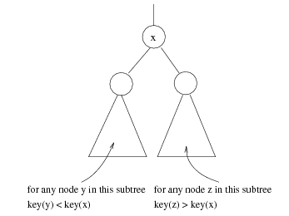
Binary Search Trees (BST)
A data structure for efficient searching, insertion and deletion
Binary search tree property
For every node X
All the keys in its left subtree are smaller than the key value in X
All the keys in its right subtree are larger than the key value in X

Slide 23
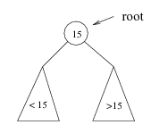
Searching BST
If we are searching for 15, then we are done.
If we are searching for a key < 15, then we should search in the left subtree.
If we are searching for a key > 15, then we should search in the right subtree.

Slide 24
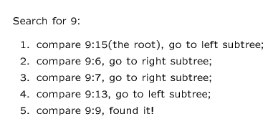
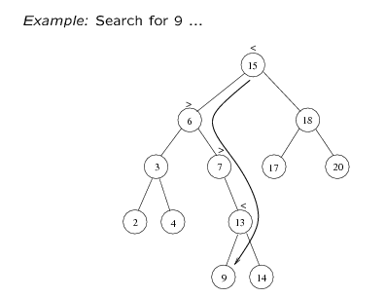

Slide 25
Searching in BST
TREE-SEARCH(x,k) // x=root of tree ,k= value to search
1 if x=NIL or k=key[x]
2 then return x
3 if k<key[x]
4 then return TREE_SEARCH(left[x],k)
5 else return TREE_SEARCH(right[x],k)
Time Complexity = O(height of Tree)

Slide 26
Find MIN / MAX
Goal: return the node containing the smallest /largest key in the tree
Algorithm: Start at the root and go left /right as long as there is a left /right child. The stopping point is the smallest /largest element

Slide 27
Find Minimum in BST
TREE_MINIMUM(x)
while Left[x] != NIL
do x=left[x]
3 return key[x]
Time Complexity = O(height of Tree)

Slide 28
Find Maximum in BST
TREE_MAXIMUM(x)
while Right[x] != NIL
do x=Right[x]
return key[x]
Time Complexity = O(height of Tree)

Slide 29
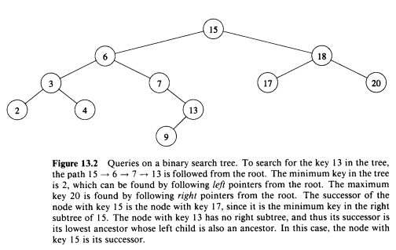
Successor of a Node
The successor of a node x is the node with the smallest key greater than key[x]
The Algorithm is broken into 2 cases.
If the right sub tree is non empty
Then successor is the leftmost node
in the right subtree.
2. If the right subtree is empty
Then the successor y of x is the lowest
ancestor of x whose left child is also an
ancestor of x.

Slide 30
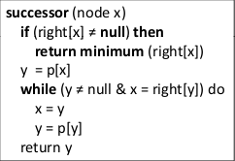
Tree successor

Slide 31
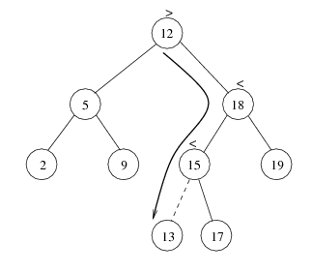
Insertion
Proceed down the tree as you would with a find
If X is found, do nothing (or update something)
Otherwise, insert X at the last spot on the path traversed
Time complexity = O(height of the tree)

Slide 32
TREE_INSERT(T,z)
Y=NIL
X=root[T]
While x!=NIL
Do y=x
If key[z] < key[x]
Then x=left[x]
Else X=right[x]
P[z]=y
If y=NIL
Then root[T]=z //tree was empty
Else if key[z]<key[y]
Then left[y]=z
Else Right[y]=z

Slide 33
Deletion
When we delete a node, we need to consider how we take care of the children of the deleted node.
This has to be done such that the property of the search tree is maintained.

Slide 34
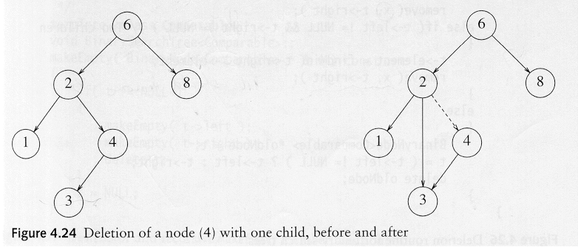
Deletion under Different Cases
Case 1: the node is a leaf
Delete it immediately
Case 2: the node has one child
Adjust a pointer from the parent to bypass that node

Slide 35
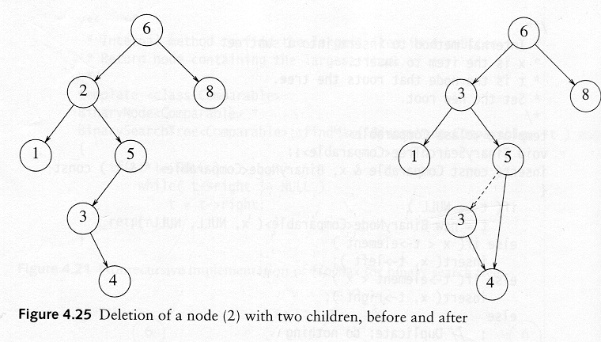
Deletion Case 3
Case 3: the node has 2 children
Replace the key of that node with the minimum element at the right sub tree
Delete that minimum element
Has either no child or only right child because if it has a left child, that left child would be smaller and would have been chosen. So invoke case 1 or 2.
Time complexity = O(height of the tree)

Slide 36
TREE-DELETE (T,z)
If left [z] = NIL or right [z] = NIL
then y ← z
else y ← TREE-SUCCESSOR (z)
If left [y] ≠ NIL
then x ← left [y]
else x ← right [y]
If x≠ NIL
then p[x] ← p[y]
If p[y]=NIL
then root[T] ← x
else if y = left [p[y]]
then left [p[y]] ← x
else right [p[y]] ← x
If y ≠ z
then key[z] ← key[y]
copy y’s satellite data into z
Return y

